Slide 1

BY RAHUL KUMAR DIXIT

Slide 2

Do not have to create an array while declaring array variable
  <type> [] variable_name;
  int [] prime;
  int prime[];
Both syntaxes are equivalent
No memory allocation at this point

Slide 3

Define an array as follows:
  variable_name=new <type>[N];
  primes=new int[10];
Declaring and defining in the same statement:
  int[] primes=new int[10];
In JAVA, int is of 4 bytes, total space=4*10=40 bytes

Slide 4

Index
prime
0 | 1 | 2 | 3 | 4 | 5 | 6 | 7 | 8 | 9
2 | 1 | 11 | -9 | 2 | 1 | 11 | 90 | 101 | 2
value

Slide 5

We define
  int[] prime=new long[20];
    MorePrimes.java:5: incompatible types
    found: long[]
    required: int[]
    int[] primes = new long[20];
    ^
The right hand side defines an array, and thus the array variable should refer to the same type of array

Slide 6
We define
  int prime[100];
    MorePrimes.java:5: ']' expected
    long primes[20];
    ^
The C++ style is not permitted in JAVA syntax

Slide 7
Valid code:
int k=7;
long[] primes = new long[k];
Invalid Code:
int k;
long[] primes =new long[k];
Compilation Output:
MorePrimes.java:6: variable k might not have been initialized
long[] primes = new long[k];
^

Slide 8

….
BufferedReader stdin = new BufferedReader (new InputStreamReader(System.in));
String inData;
int num;
System.out.println("Enter a Size for Array:");
inData = stdin.readLine();
num = Integer.parseInt( inData ); // convert inData to int
long[] primes = new long[num];
System.out.println(“Array Length=”+primes.length);
….
SAMPLE RUN:
Enter a Size for Array:
4
Array Length=4

Slide 9

When array is created, array elements are initialized
  Numeric values (int, double, etc.) to 0
  Boolean values to false
  Char values to ‘\u0000’ (unicode for blank character)
  Class types to null

Slide 10

Index of an array is defined as
  Positive int, byte or short values
  Expression that results into these types
Any other types used for index will give error
  long, double, etc.
  Incase Expression results in long, then type cast to int
Indexing starts from 0 and ends at N-1
  primes[2]=0;
  int k = primes[2];
  …

Slide 11

JAVA checks whether the index values are valid at runtime
  If index is negative or greater than the size of the array then an IndexOutOfBoundException will be thrown
  Program will normally be terminated unless handled in the try {} catch {}

Slide 12
long[] primes = new long[20];
primes[25]=33;
….
Runtime Error:
Exception in thread “main” java.lang.ArrayIndexOutOfBoundsException: 25
at MorePrimes.main(MorePrimes.java:6)

Slide 13

Array variable is separate from array itself
  Like a variable can refer to different values at different points in the program
  Use array variables to access different arrays
  int[] primes=new int[10];
  ……
  primes=new int[50];
Previous array will be discarded
Cannot alter the type of array

Slide 14

Initialize and specify size of array while declaring an array variable
  int[] primes={2,3,5,7,11,13,17}; //7 elements
You can initialize array with an existing array
  int[] even={2,4,6,8,10};
  int[] value=even;
  One array but two array variables!
  Both array variables refer to the same array
  Array can be accessed through either variable name

Slide 15

even
0 | 1 | 2 | 3 | 4
2 | 4 | 6 | 8 | 10
value

Slide 16

long[] primes = new long[20];
primes[0] = 2;
primes[1] = 3;
long[] primes2=primes;
System.out.println(primes2[0]);
primes2[0]=5;
System.out.println(primes[0]);

Slide 17

2
5

Slide 18

Refer to array length using length
  A data member of array object
  array_variable_name.length
  for(int k=0; k<primes.length;k++)
    ….
Sample Code:
  long[] primes = new long[20];
  System.out.println(primes.length);
Output: 20

Slide 19

If number of elements in the array are changed, JAVA will automatically change the length attribute!

Slide 20

class MinAlgorithm
{
public static void main ( String[] args )
{
  int[] array = { -20, 19, 1, 5, -1, 27, 19, 5 } ;
  int min=array[0]; // initialize the current minimum
  for ( int index=0; index < array.length; index++ )
  if ( array[ index ] < min )
  min = array[ index ] ;
  System.out.println("The minimum of this array is: " + min );
}
}
*Program taken from: http://chortle.ccsu.edu/CS151/Notes/chap47/ch47_10.html

Slide 21

Two-Dimensional arrays
  float[][] temperature=new float[10][365];
  10 arrays each having 365 elements
  First index: specifies array (row)
  Second Index: specifies element in that array (column)
  In JAVA float is 4 bytes, total Size=4*10*365=14,600 bytes

Slide 22
Sample[0]
0 | 1 | 2 | 3 | 4 | 5 | 6 | 7 | 8 | 9
Sample[1]
0 | 1 | 2 | 3 | 4 | 5 | 6 | 7 | 8 | 9
Sample[2]
0 | 1 | 2 | 3 | 4 | 5 | 6 | 7 | 8 | 9

Slide 23

int[][] array2D = { {99, 42, 74, 83, 100}, {90, 91, 72, 88, 95}, {88, 61, 74, 89, 96}, {61, 89, 82, 98, 93}, {93, 73, 75, 78, 99}, {50, 65, 92, 87, 94}, {43, 98, 78, 56, 99} };
//5 arrays with 5 elements each

Slide 24
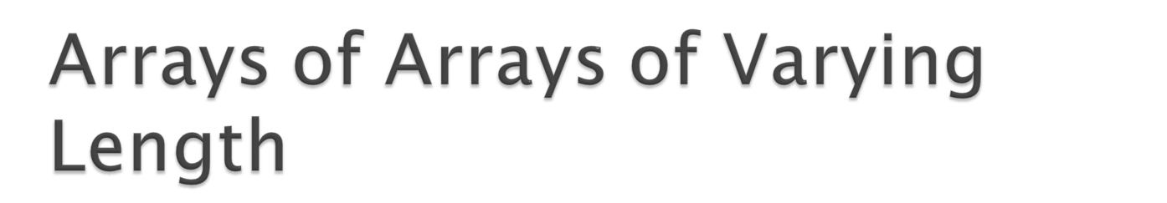
All arrays do not have to be of the same length
  float[][] samples;
  samples=new float[6][];//defines # of arrays
  samples[2]=new float[6];
  samples[5]=new float[101];
Not required to define all arrays

Slide 25

int[][] uneven = { { 1, 9, 4 }, { 0, 2}, { 0, 1, 2, 3, 4 } };
//Three arrays
//First array has 3 elements
//Second array has 2 elements
//Third array has 5 elements

Slide 26

long[][] primes = new long[20][];
primes[2] = new long[30];
System.out.println(primes.length); //Number of arrays
System.out.println(primes[2].length);//Number of elements in the second array
OUTPUT:
20
30

Slide 27
class unevenExample3
{
public static void main( String[] arg )
{ // declare and construct a 2D array
int[][] uneven = { { 1, 9, 4 }, { 0, 2}, { 0, 1, 2, 3, 4 } };
// print out the array
for ( int row=0; row < uneven.length; row++ ) //changes row
{
System.out.print("Row " + row + ": ");
for ( int col=0; col < uneven[row].length; col++ ) //changes column
System.out.print( uneven[row][col] + " "); System.out.println();
}
}
}

Slide 28
Row 0: 1 9 4
Row 1: 0 2
Row 2: 0 1 2 3 4

Slide 29

Triangular Array
  for(int k=0; k<samples.length;k++)
  samples[k]=new float[k+1];

Slide 30

A farmer has 10 farms of beans each in 5 countries, and each farm has 30 fields!
Three-dimensional array
  long[][][] beans=new long[5][10][30];
  //beans[country][farm][fields]

Slide 31
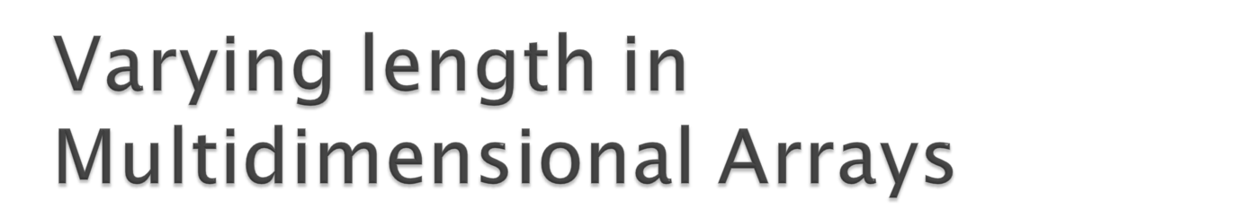
Same features apply to multi-dimensional arrays as those of 2 dimensional arrays
  long beans=new long[3][][];//3 countries
  beans[0]=new long[4][];//First country has 4 farms
  beans[0][4]=new long[10];
  //Each farm in first country has 10 fields

Slide 32

Arrays can be used to store objects
  Circle[] circleArray;
  circleArray = new Circle[25];
The above statement creates an array that can store references to 25 Circle objects.
Circle objects are not created.

Slide 33
Create the Circle objects and stores them in the array.
  //declare an array for Circle
  Circle circleArray[] = new Circle[25];
  int r = 0;
  // create circle objects and store in array
  for (r=0; r <25; r++)
  circleArray[r] = new Circle(r);

